Slide 1

Real Estate Management Project

Slide 2
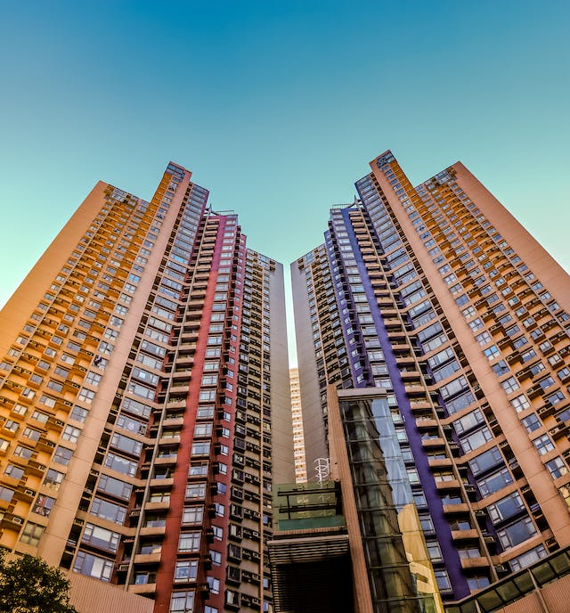
Introduction
The Real Estate Property Management System is vital for property managers to track tenants' leases and generate financial reports efficiently.
This system strives to bridge the gap in property management by providing a comprehensive and user-friendly solution

Slide 3

Background of the Project
The background of this project stems from the growing need for modern, tech-driven solutions in the real estate industry, where manual and fragmented systems often lead to inefficiencies.
By leveraging technology, the application seeks to enhance property management workflows, improve user experience, and ultimately optimize the overall efficiency of real estate operations.

Slide 4
Problem Statement
Property managers need help with manual record-keeping, leading to inefficiencies and a lack of real-time insights. They rely on scattered spreadsheets and paper documents, hindering their ability to maximize occupancy rates, streamline lease management, and make data-driven financial decisions

Slide 5
The proposed Solution
Our Real Estate Property Management System has the following key features:
Tenant Management
Lease Tracking
Property Management
Maintenance Requests

Slide 6
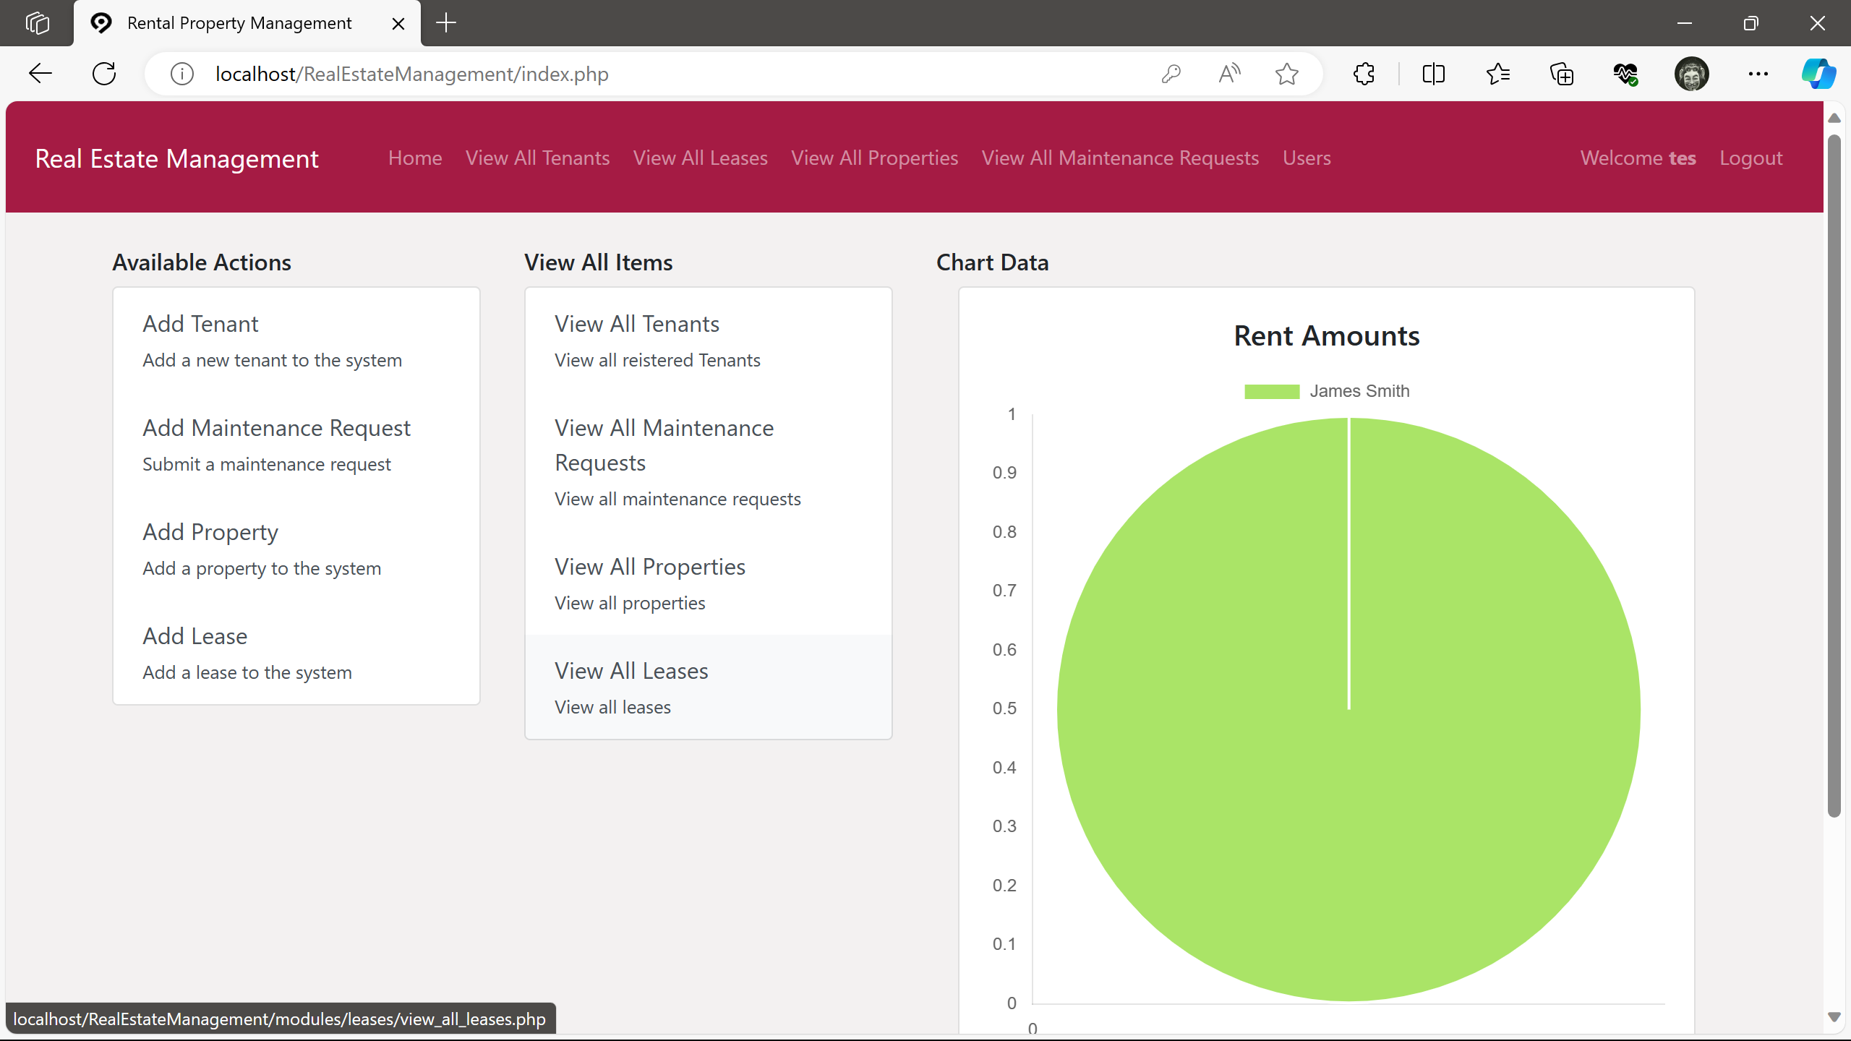
The proposed Solution

Slide 7
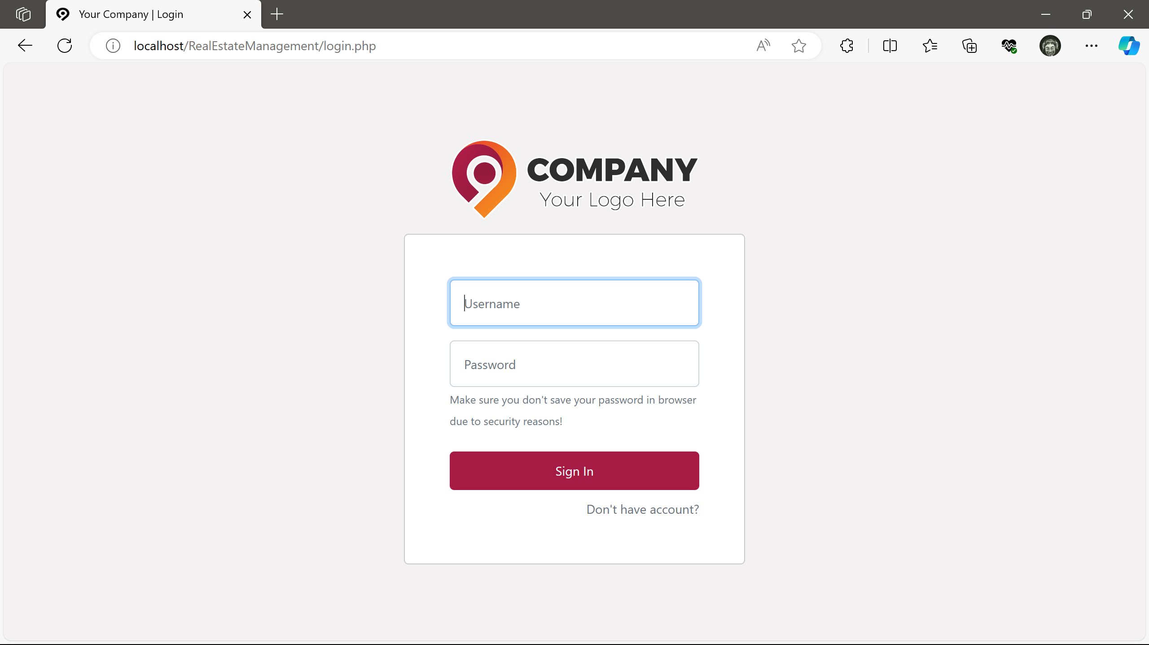
User Authentication
Users are authenticated and authorized correctly

Slide 8
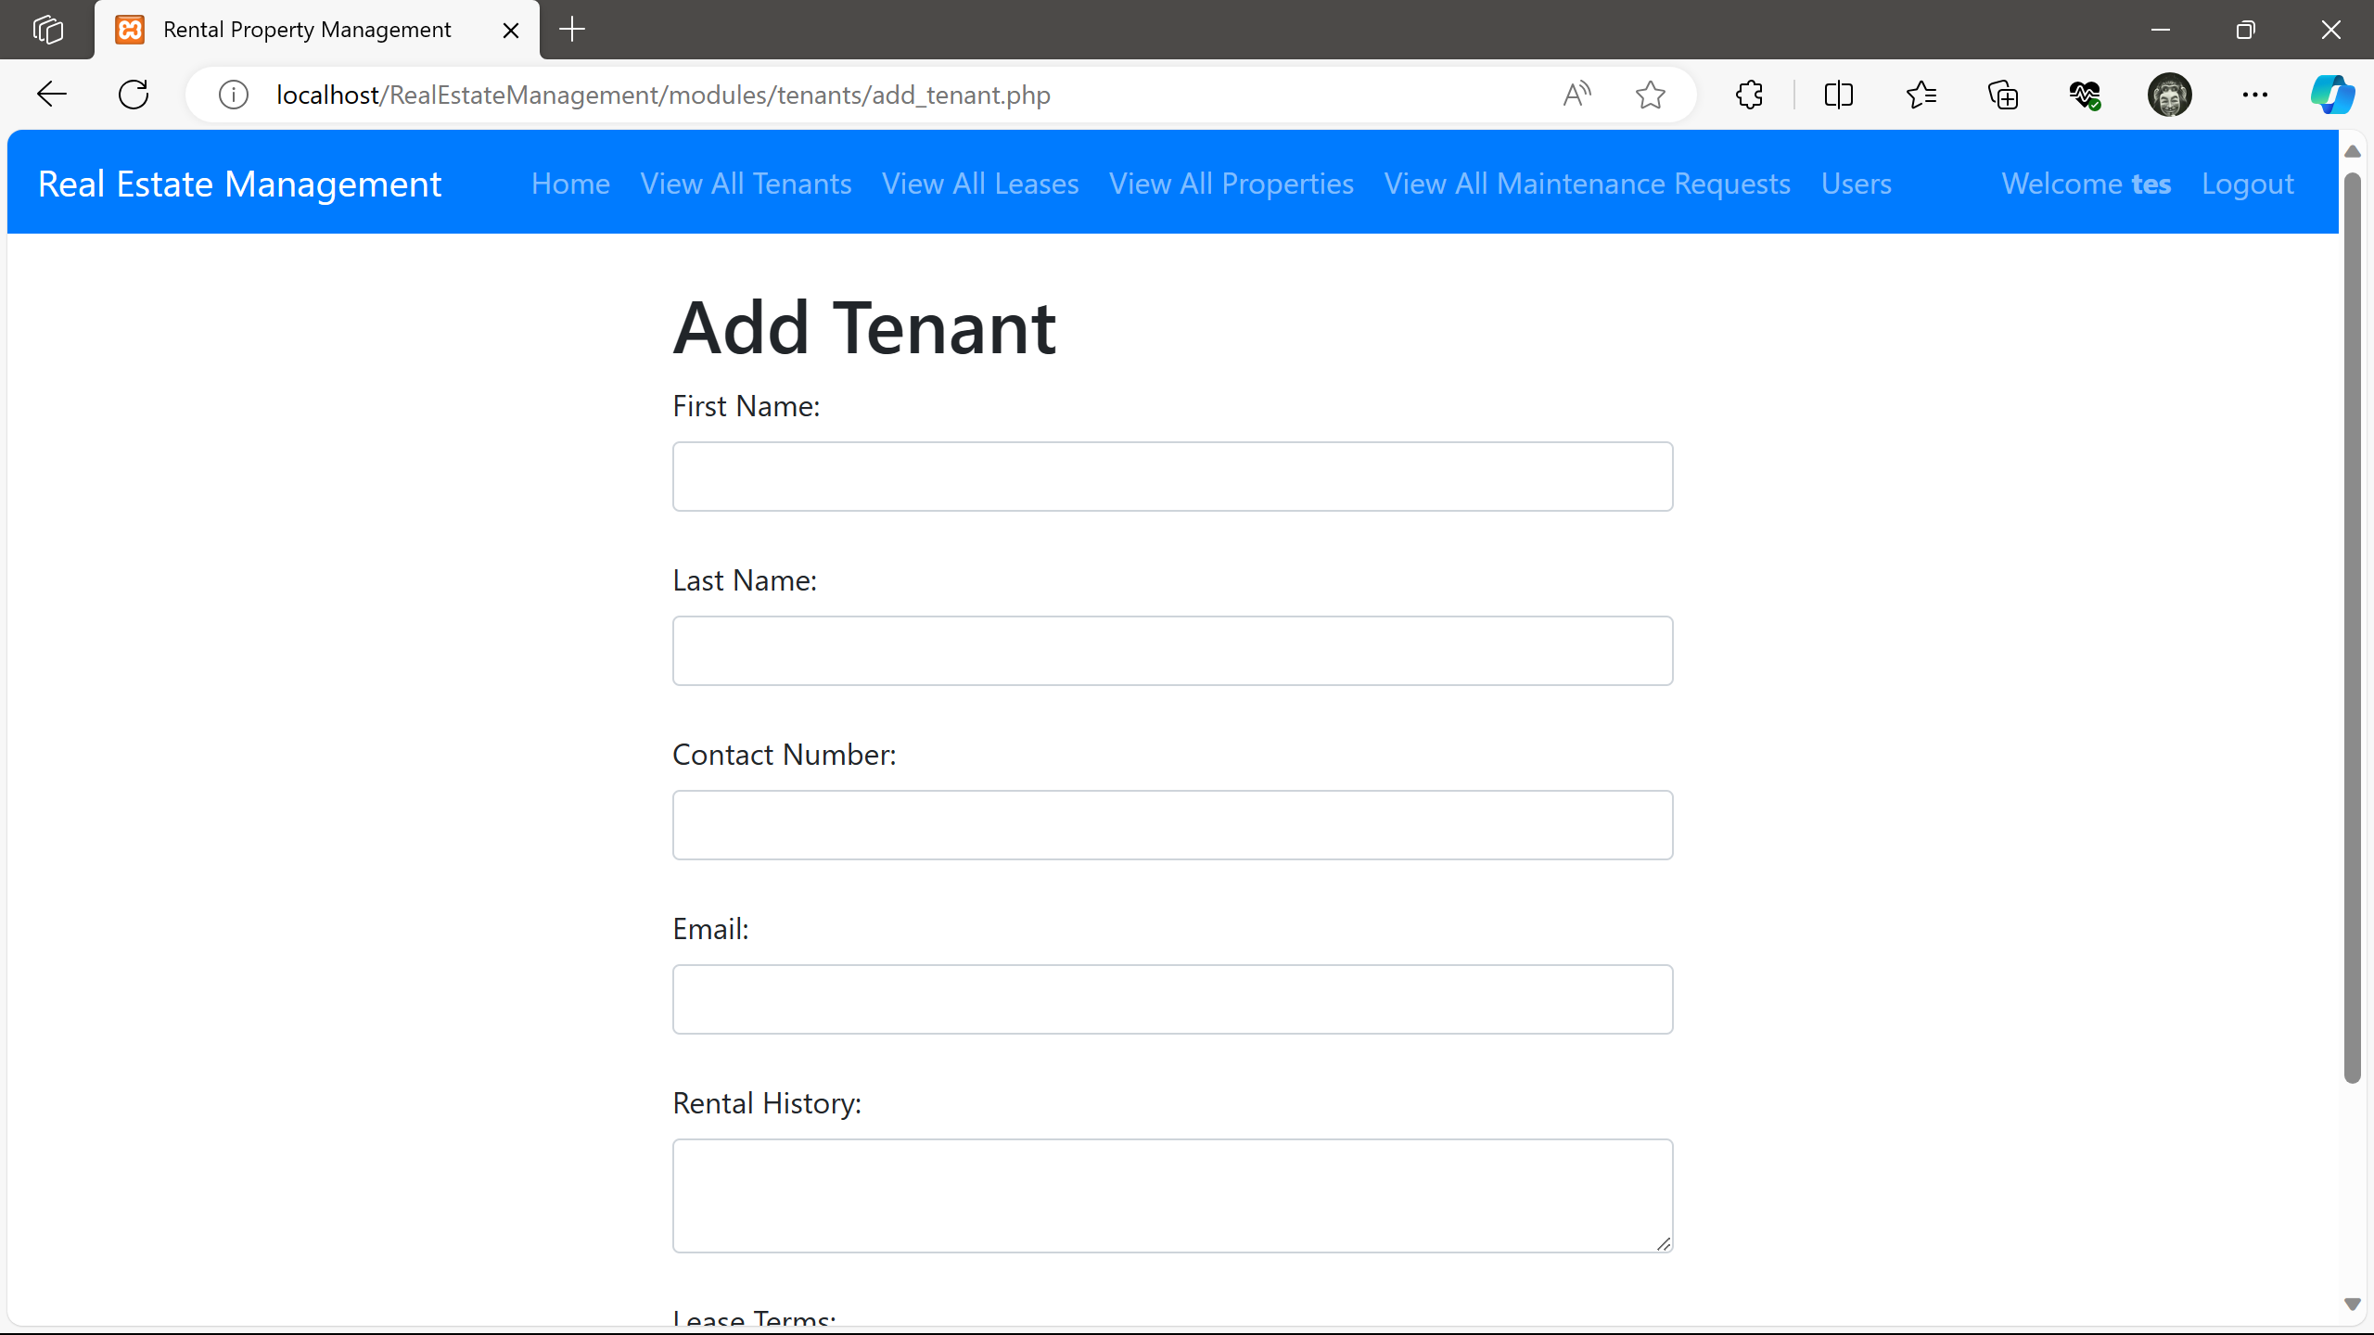
1. Tenant Management
The User is able to create and maintain detailed tenant profiles, including contact information, rental history, and lease terms

Slide 9
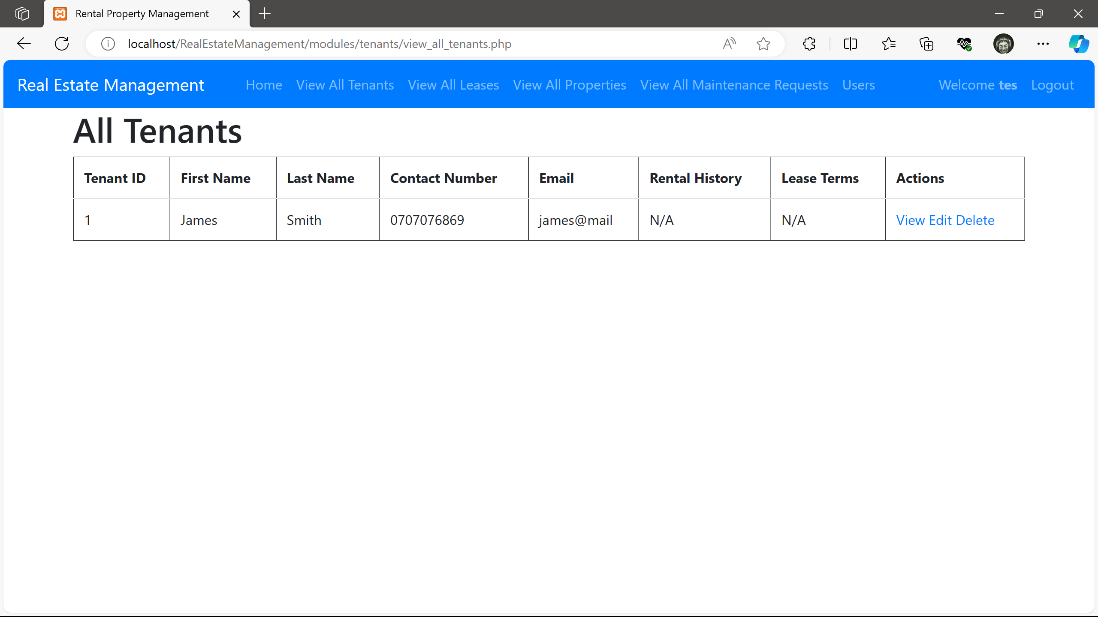
1. Tenant Management
View a listing of all tenants and perform various actions on the tenant record

Slide 10
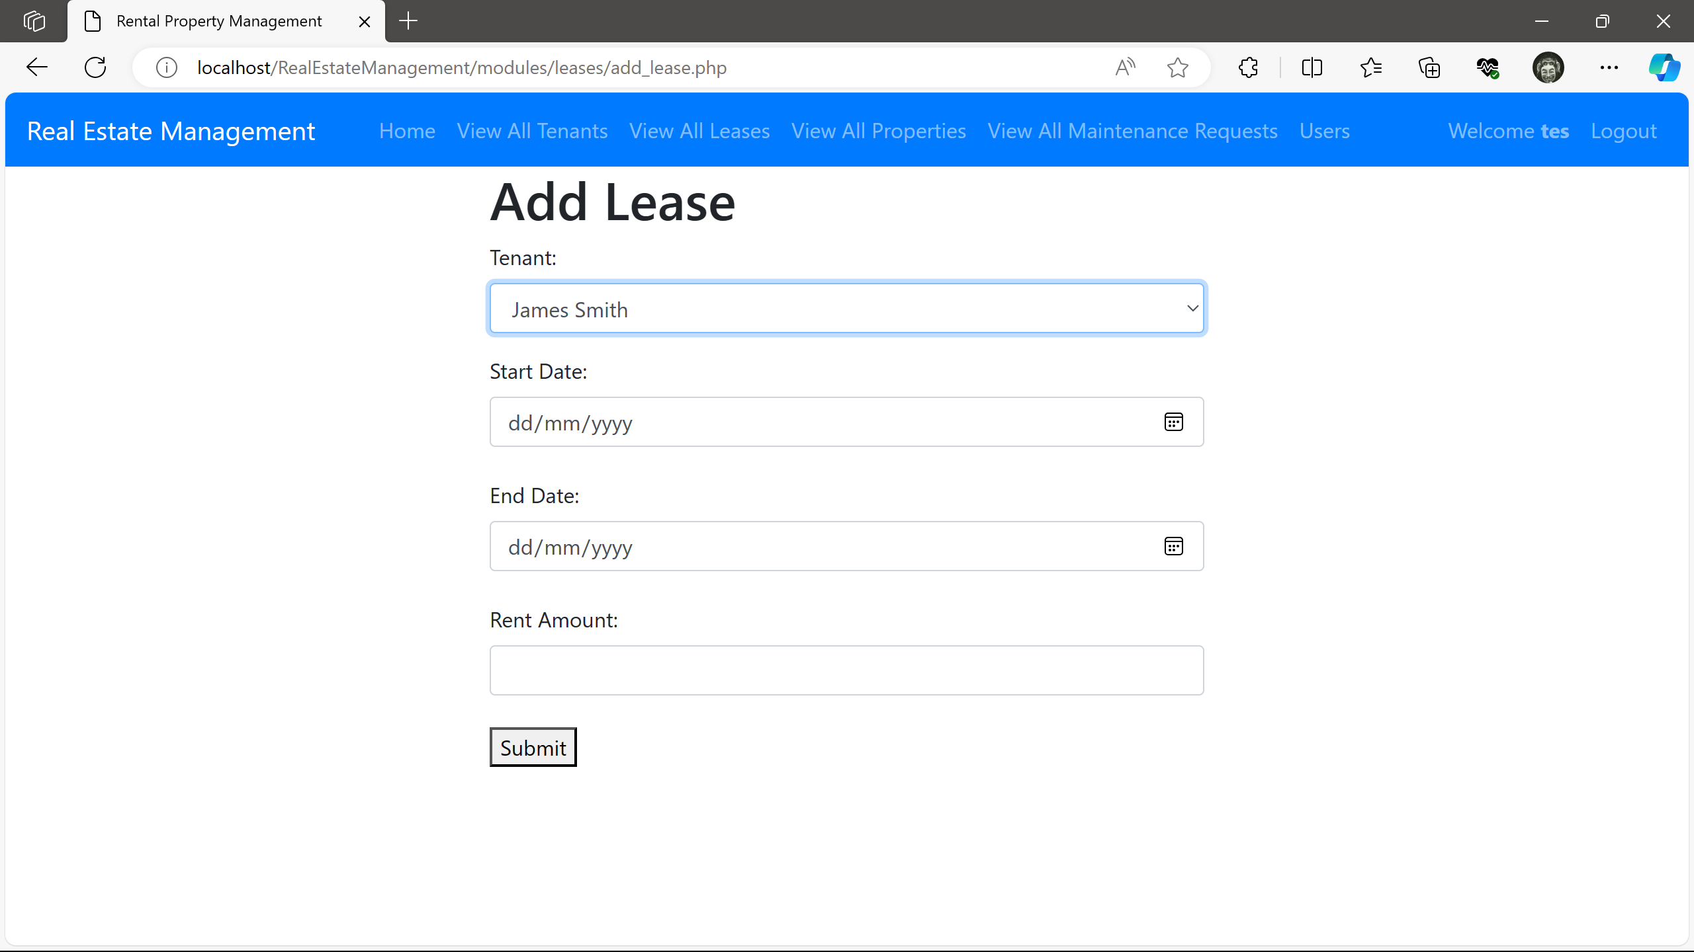
2. Lease Tracking
Add a lease to the current lease records

Slide 11
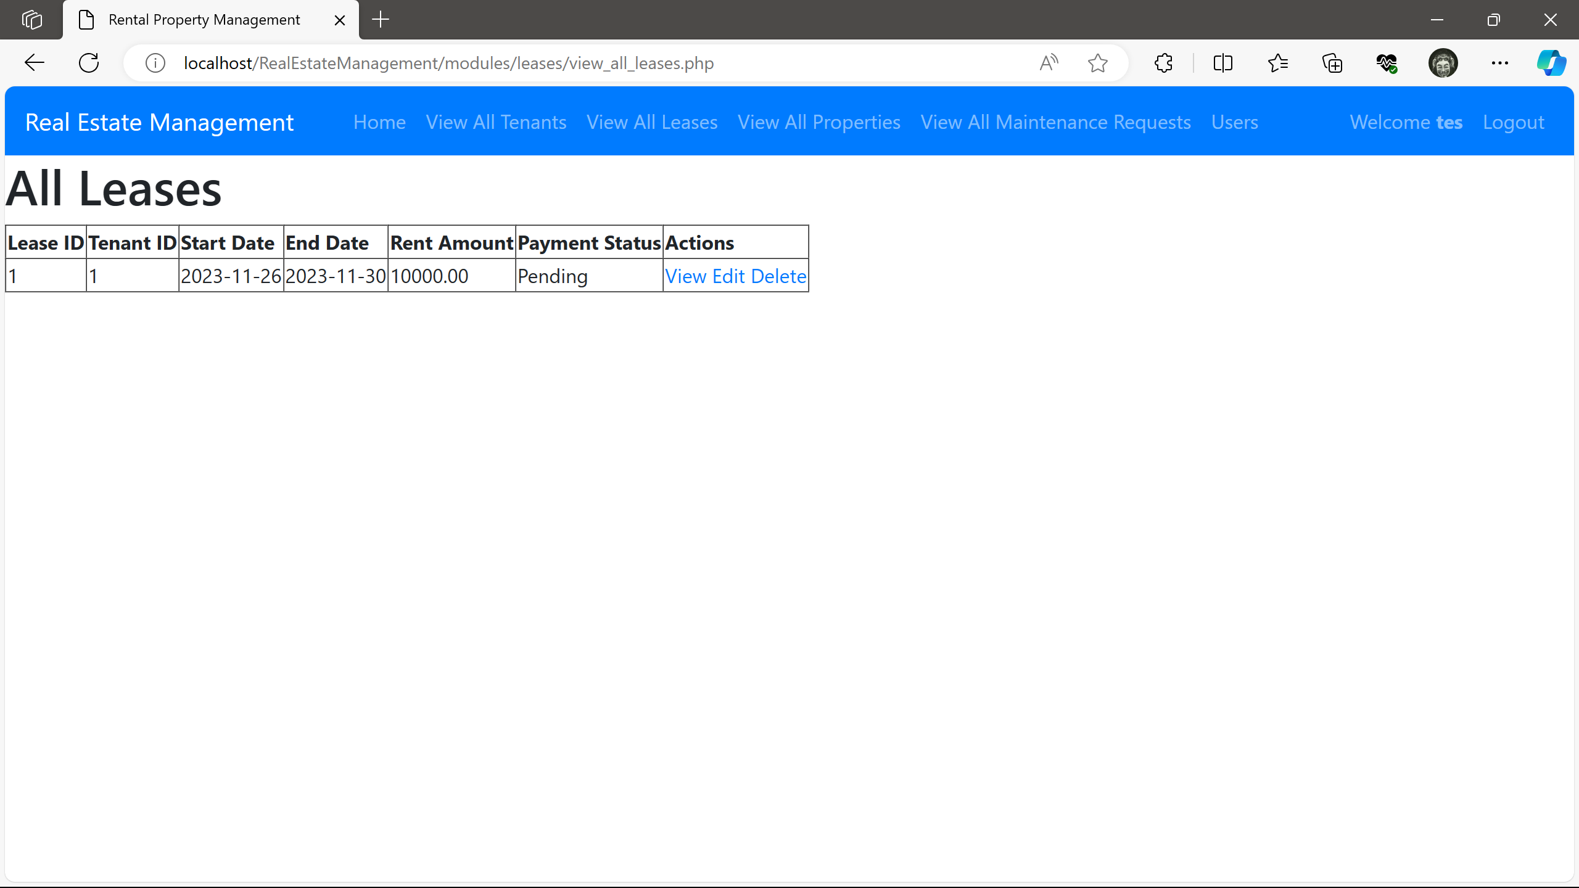
2. Lease Tracking
View a listing of all leases and perform various actions on the lease record

Slide 12
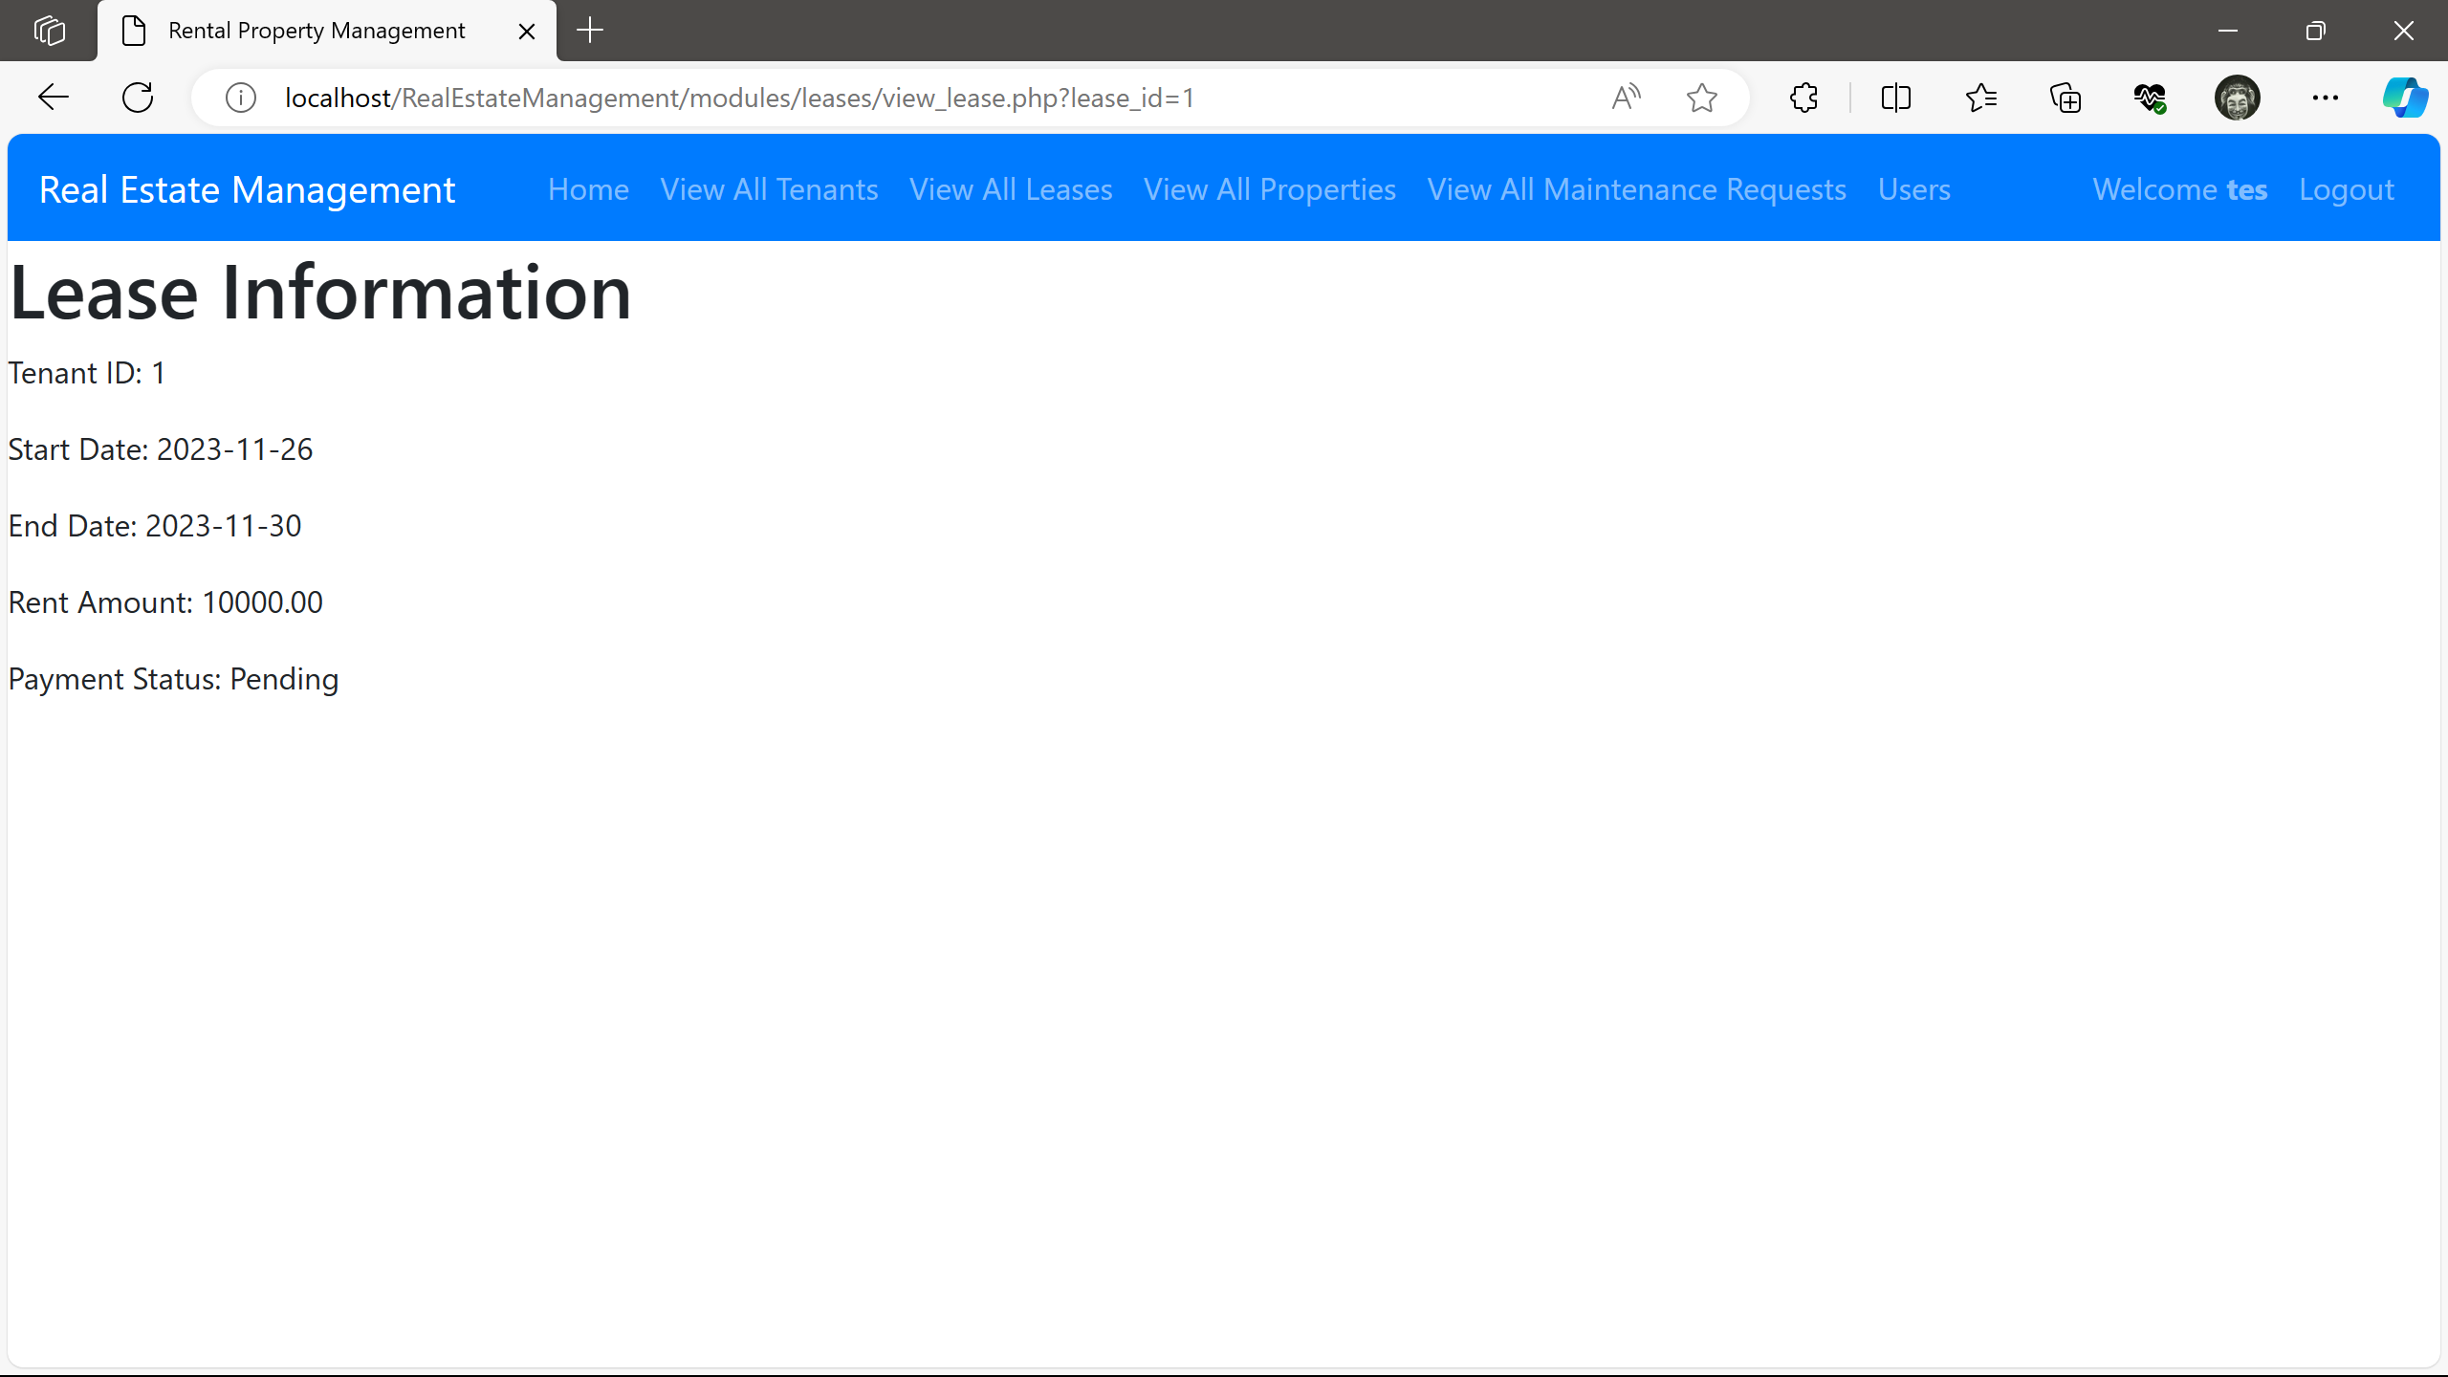
2. Lease Tracking
View a detailed view of the lease information

Slide 13
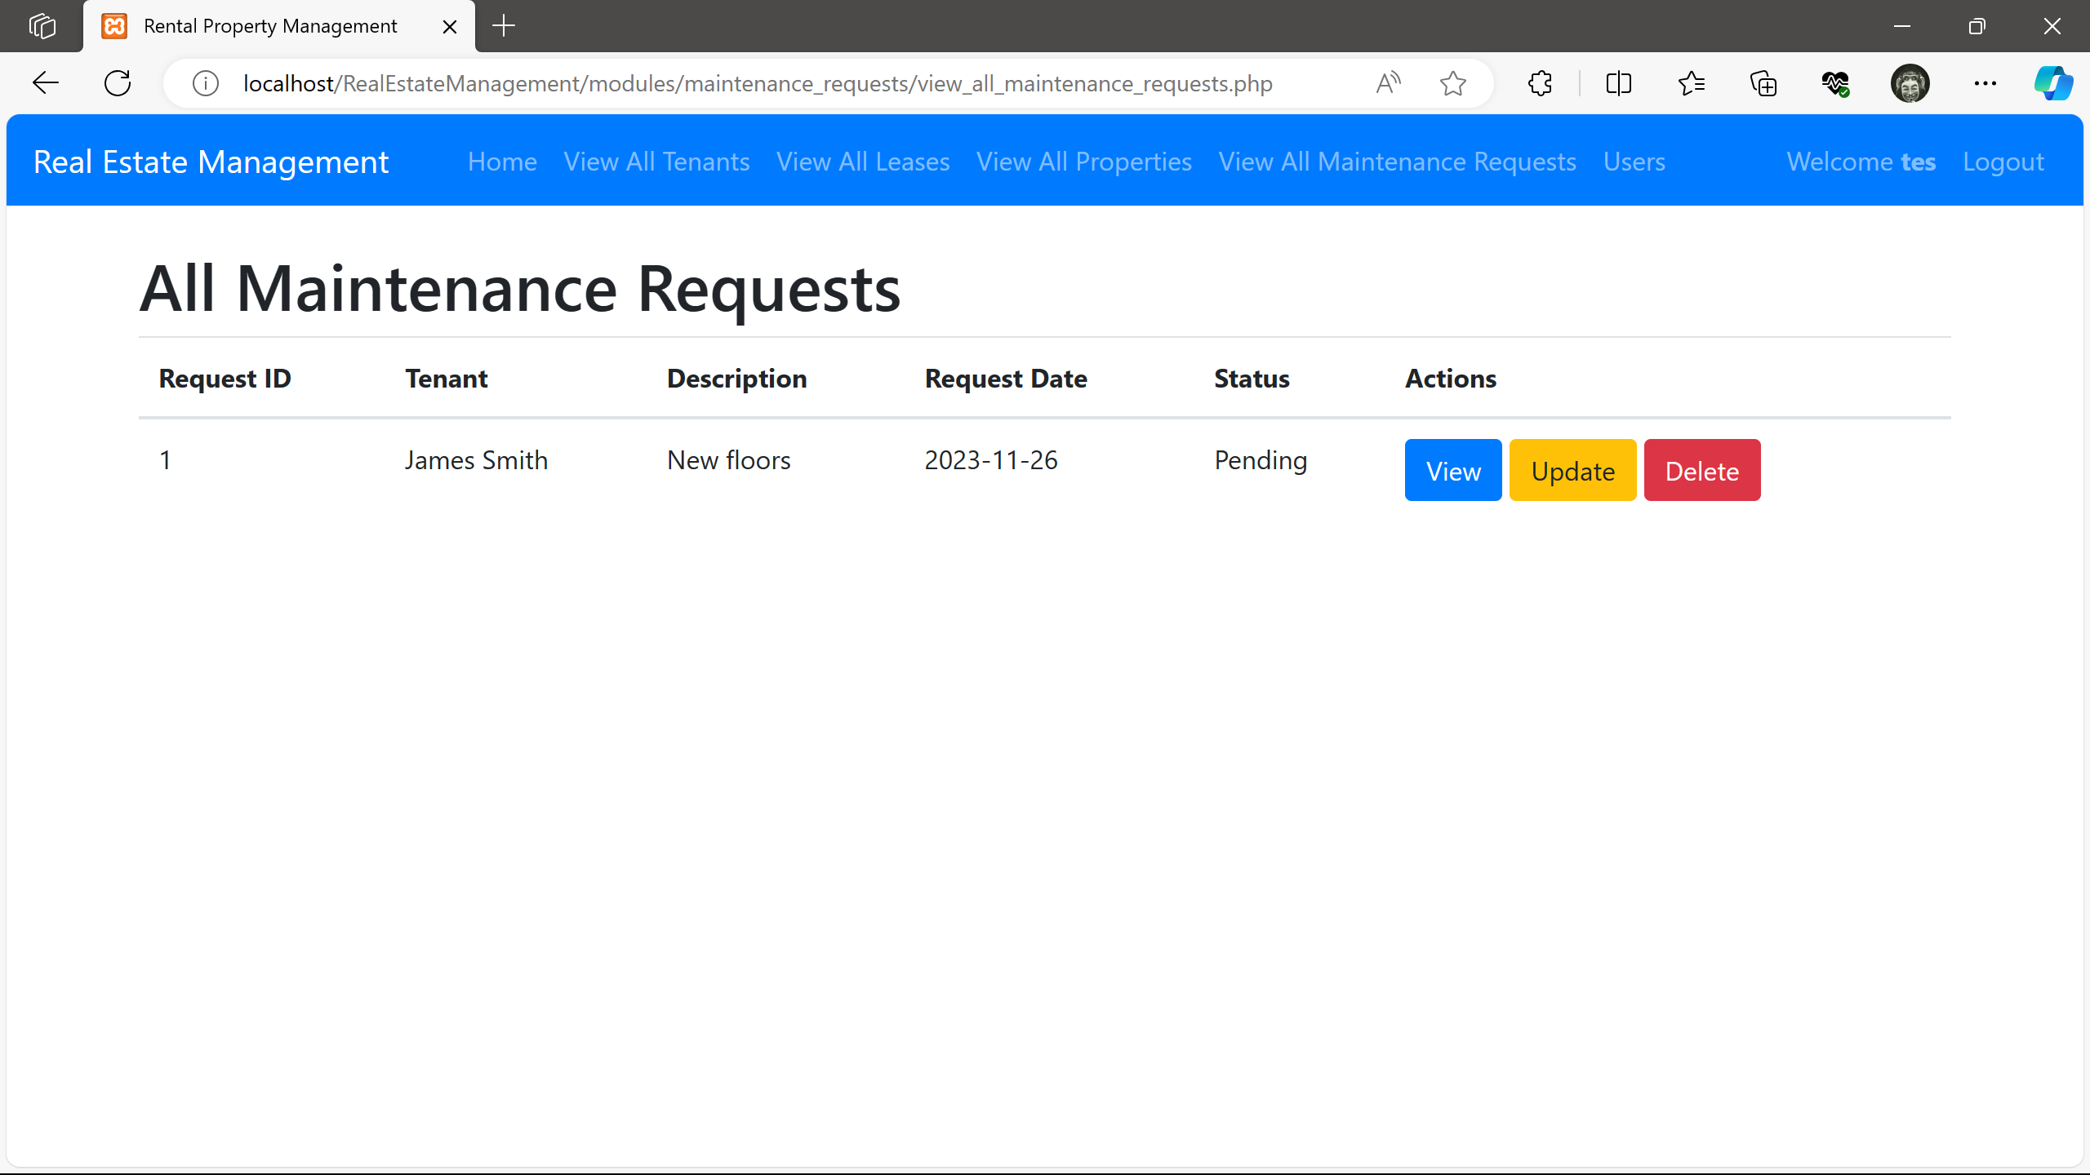
3 Maintenance Requests
View all Maintenance Requests in the database, and get detailed information about it

Slide 14
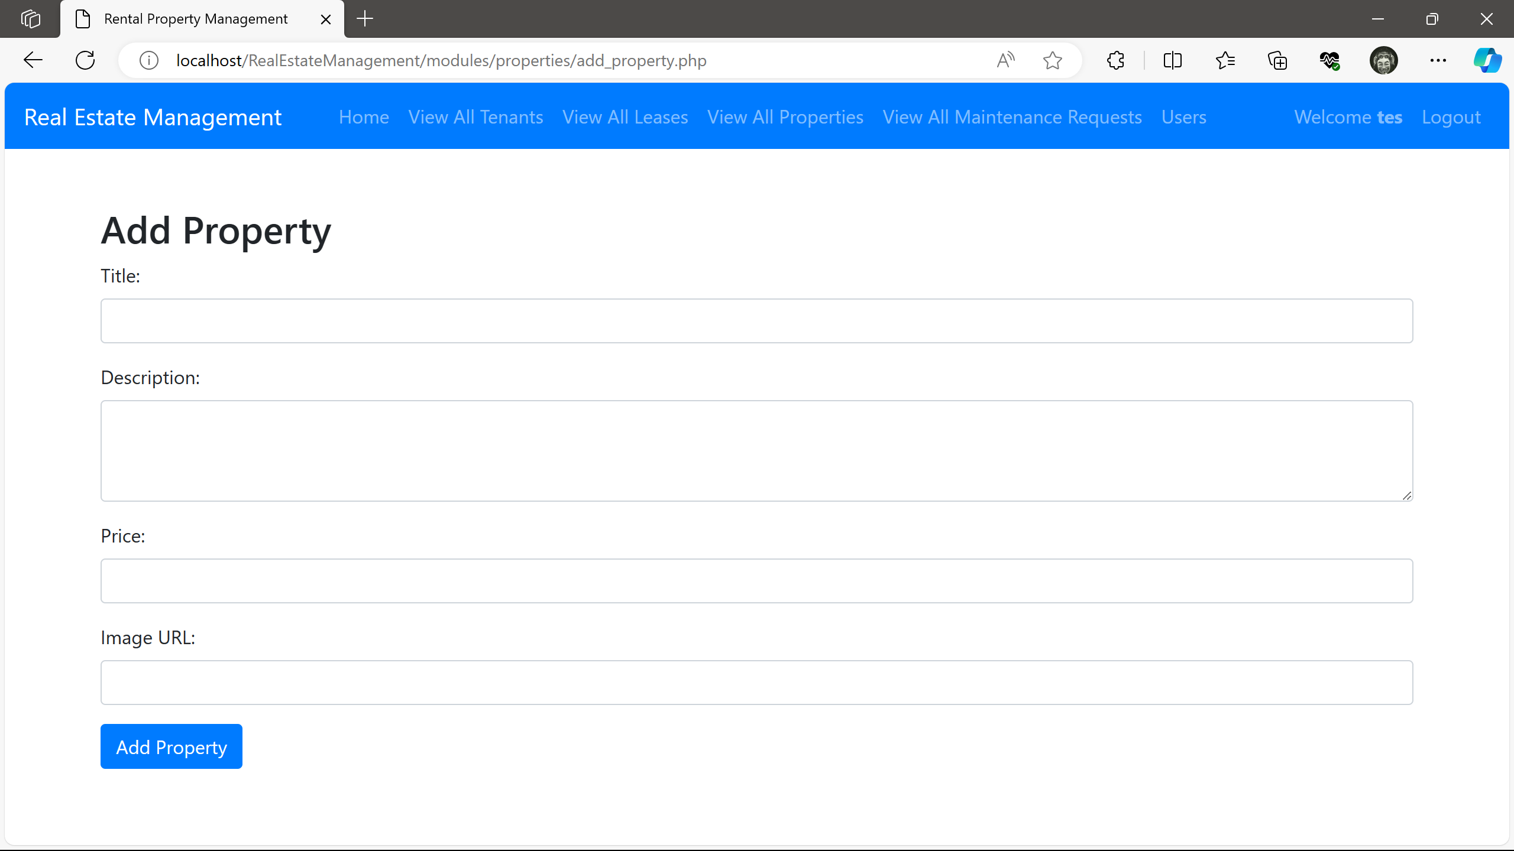
3 Property Management
Add, view a property in the database, and get detailed information about it

Slide 15
Discussion
The real estate management web application aims to streamline property operations, offering a centralized platform for property owners, managers, and tenants.
By leveraging digital tools, the project aims to enhance efficiency in tasks such as lease management, maintenance requests, and financial tracking.
With a user-friendly interface, it provides stakeholders with real-time insights, empowering them to make informed decisions and ensure the smooth functioning of their real estate portfolios.

Slide 16
Conclusion
In conclusion, the real estate management web application stands as a transformative solution, poised to revolutionize the way property management is executed.
Through meticulous design and functionality, meets the demands of current real estate professionals, offering a seamless and intuitive experience

Slide 17
Team members and Contributions
Sumanth kabalayi
Database design and integration
2. Praneeth kurra
Database integration and Frontend Design
3. Sathyanarayana Chowdary pynni
Design, System archecture and Development

Slide 18
Any questions?
Notes:
In Slide Show mode, select the arrows to visit links.

